Slide 1
DWM 2.0
Daily Work Management
Progress Status

Slide 2
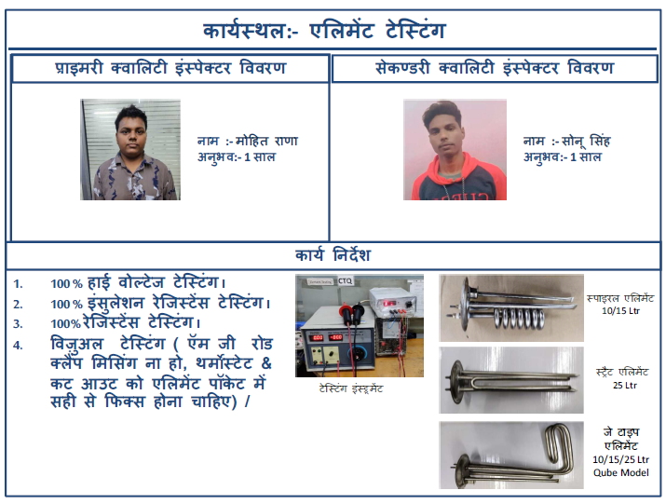
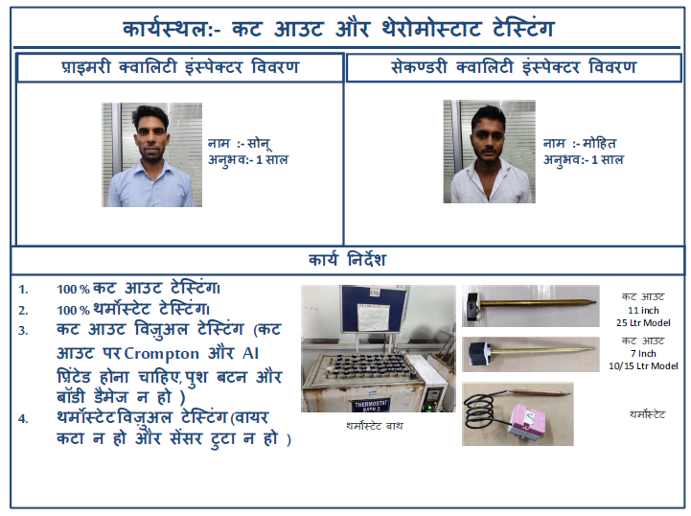
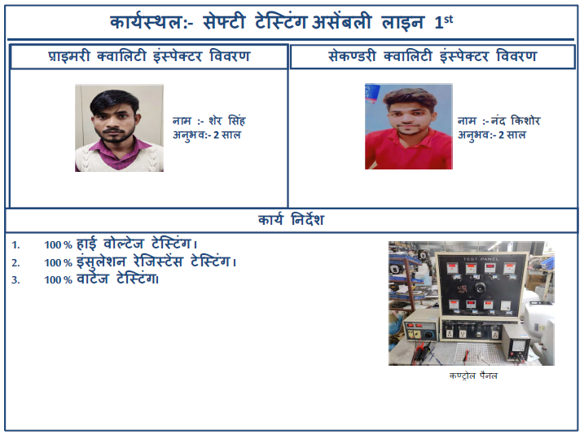
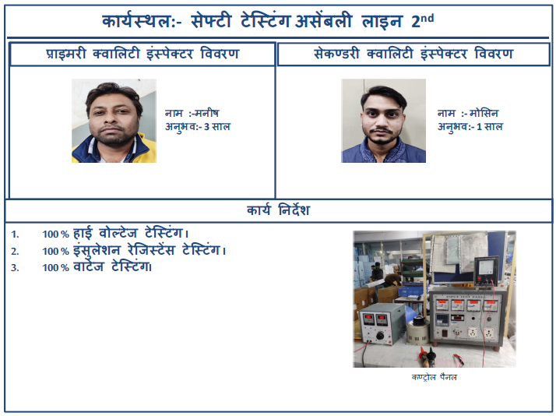
Fixing of CTQ operators - Primary and Secondary With OJT Module

Slide 3
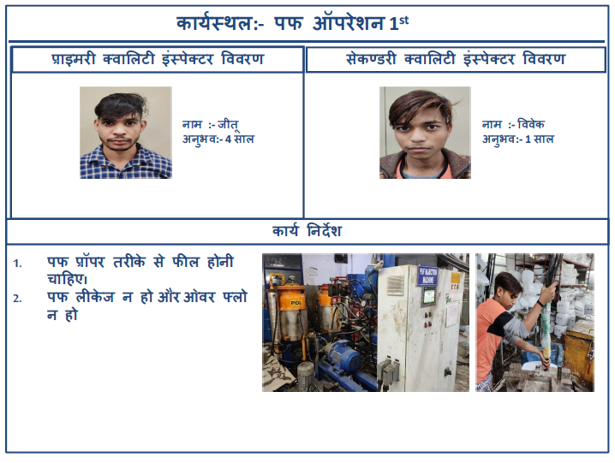
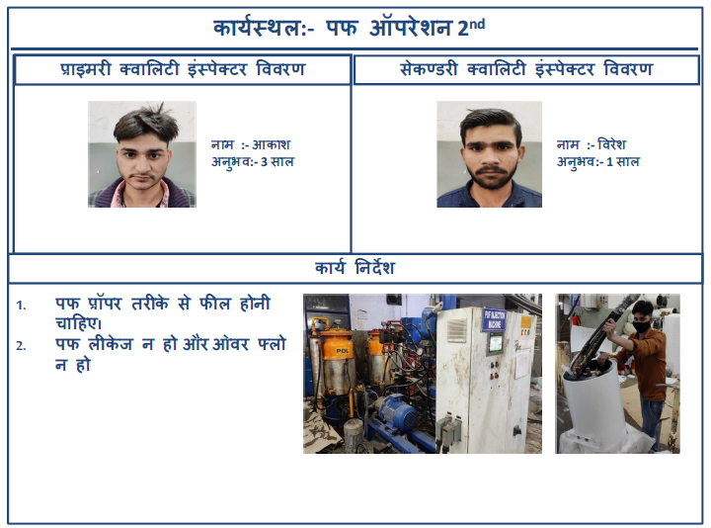
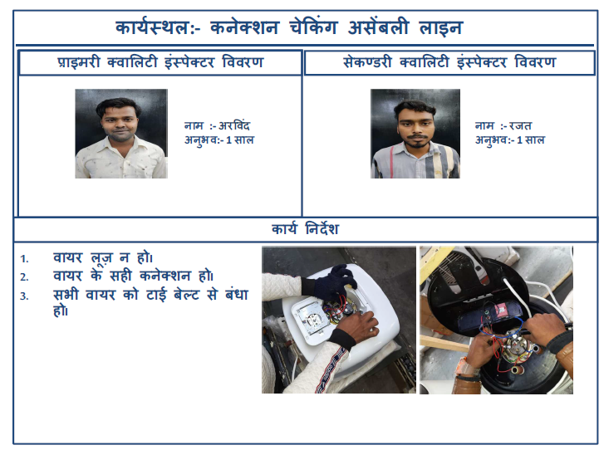
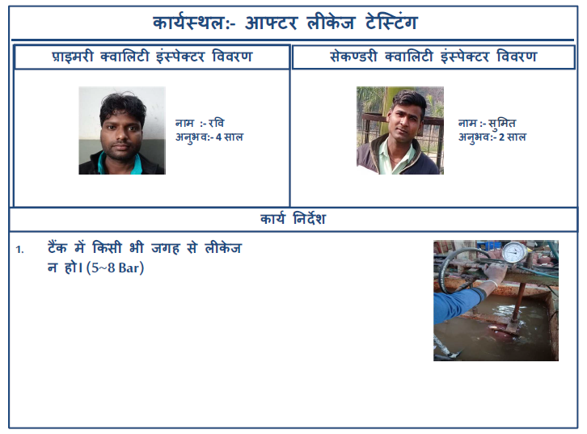
Fixing of CTQ operators - Primary and Secondary With OJT Module

Slide 4
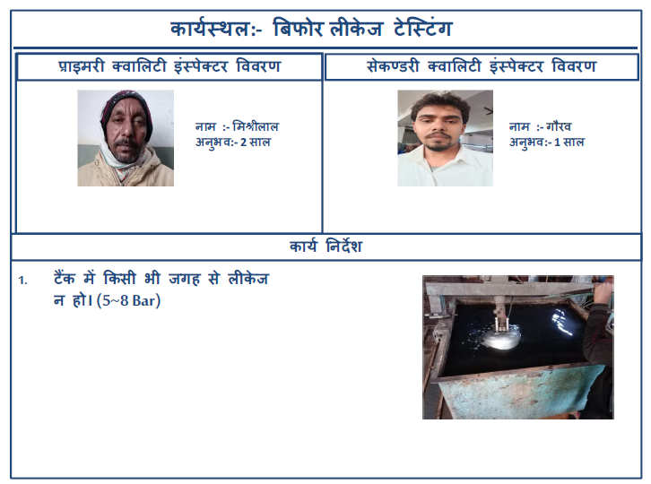
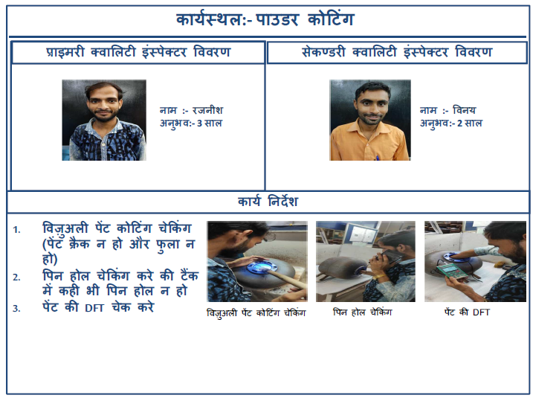
Fixing of CTQ operators - Primary and Secondary With OJT Module

Slide 5
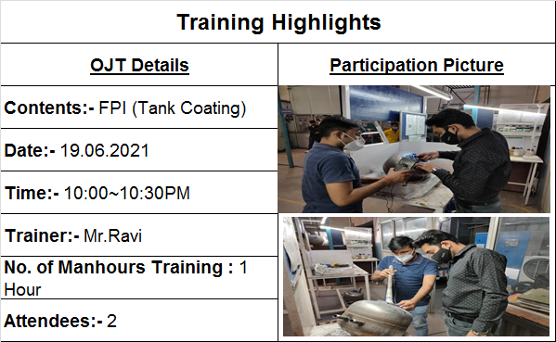
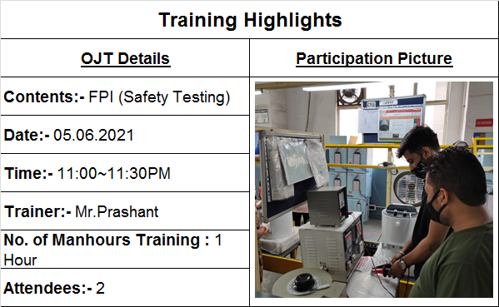
FPI Training
Condition for First Part Inspection:
Starting of shift
Model Changeover
Machine breakdown
power interruption
tool change

Slide 6
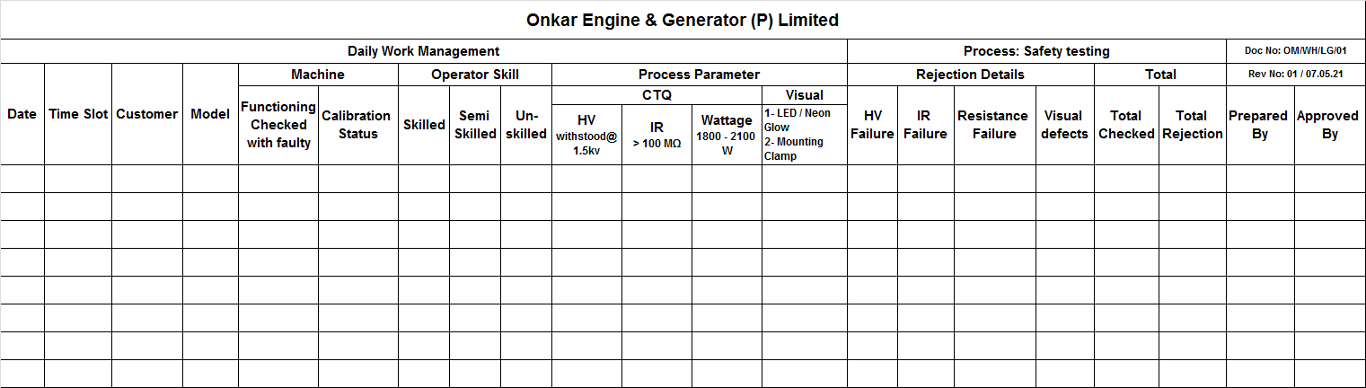
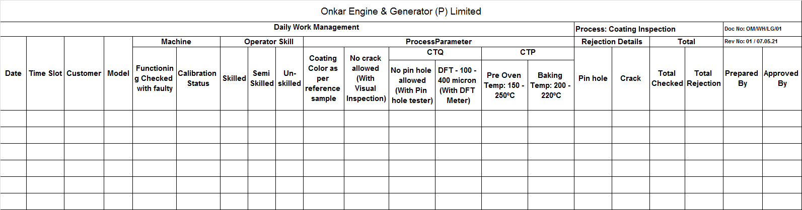
Log Book Updated
CTQ & CTP check point added in Log book

Slide 7
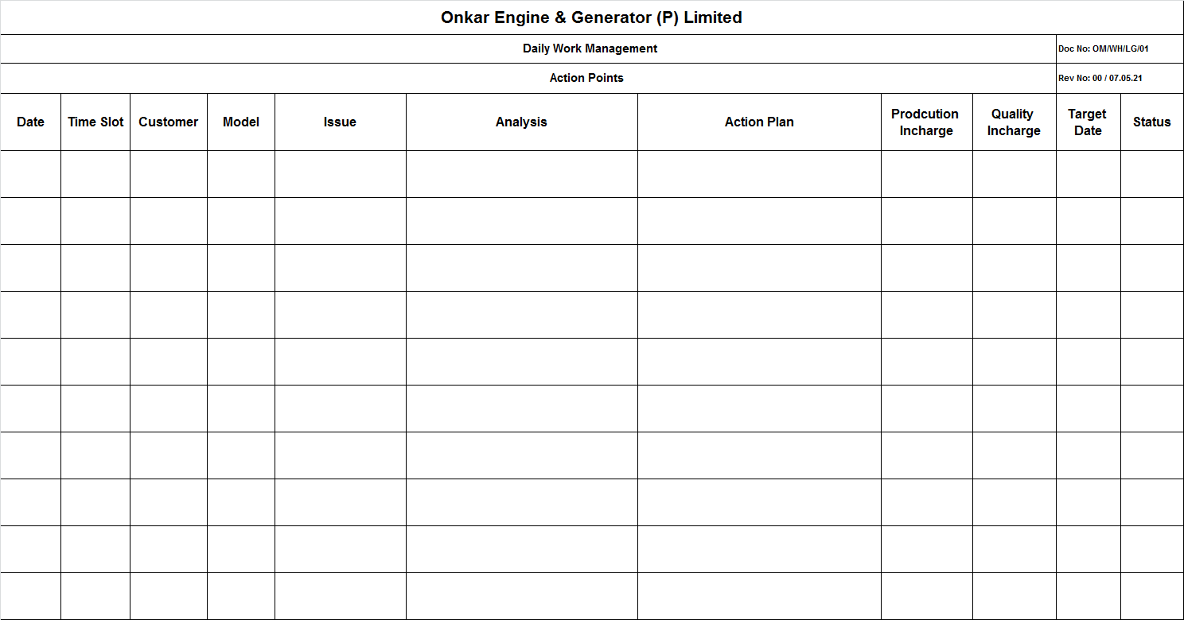
Log Book Action Plan check sheet

Slide 8
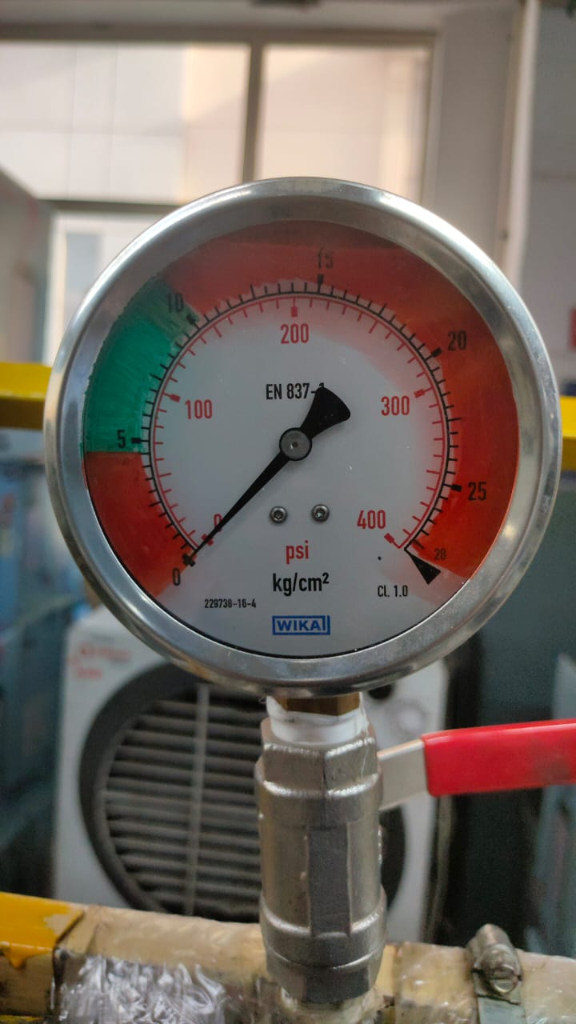
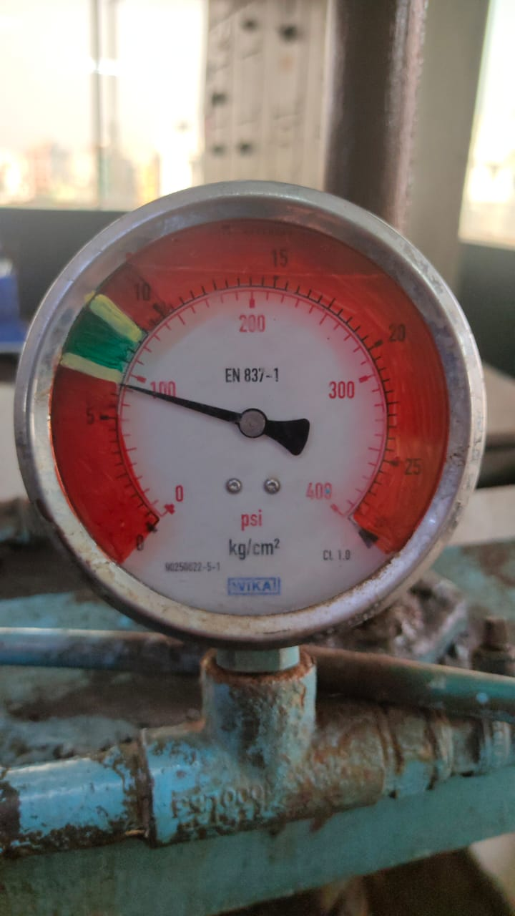
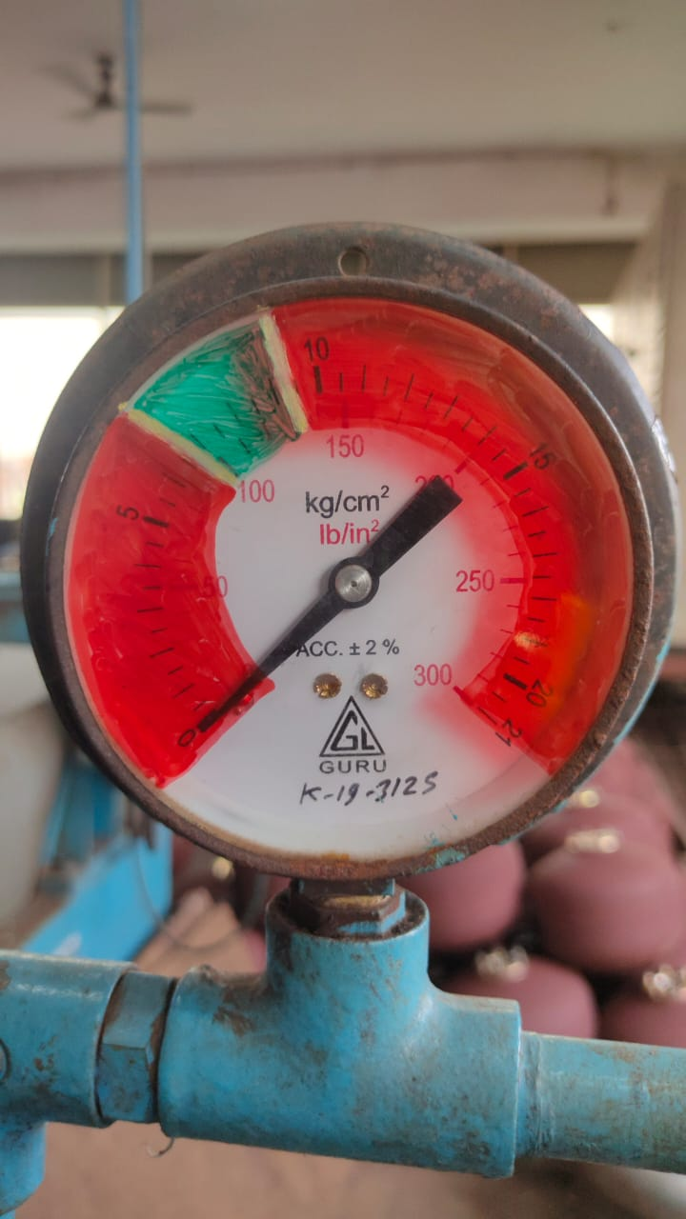
Color mark on Pressure Gauges
Color Coding :
Red : Danger
Yellow : Warning
Green : OK

Slide 9
Control Chart
Part Name - Tank Coating 25 ltr Qube
Instrument – Coating Tester
Least Count – 0.1 µm
Specification – 100~400 µm
Sample Size – 50 Nos.
USL = 400 µm
LSL = 100 µm
Calculation
For X-Bar Chart
UCL = 357.6
LCL = 255.4
For R-Chart
UCL = 182.2
LCL = 0
Process is good

Slide 10
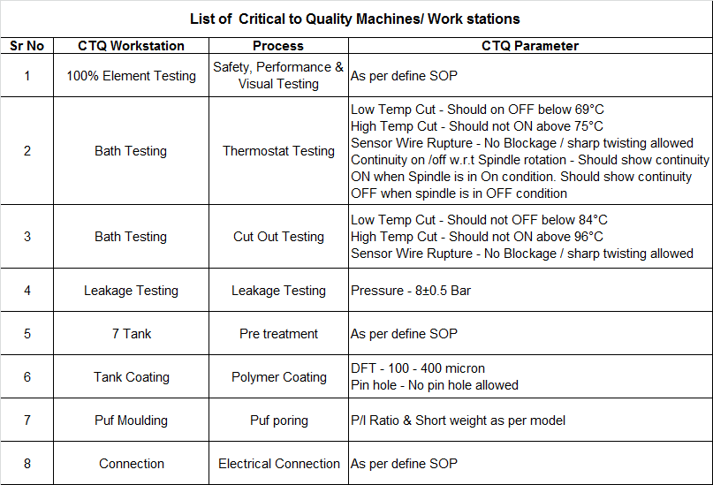
List of CTQ Work station

Slide 11
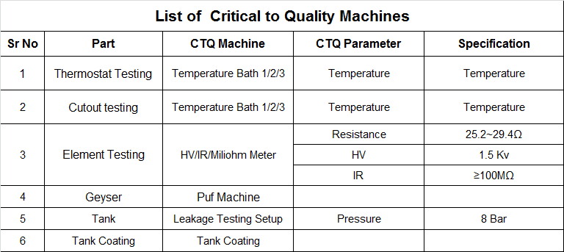
List of CTQ Machines

Slide 12
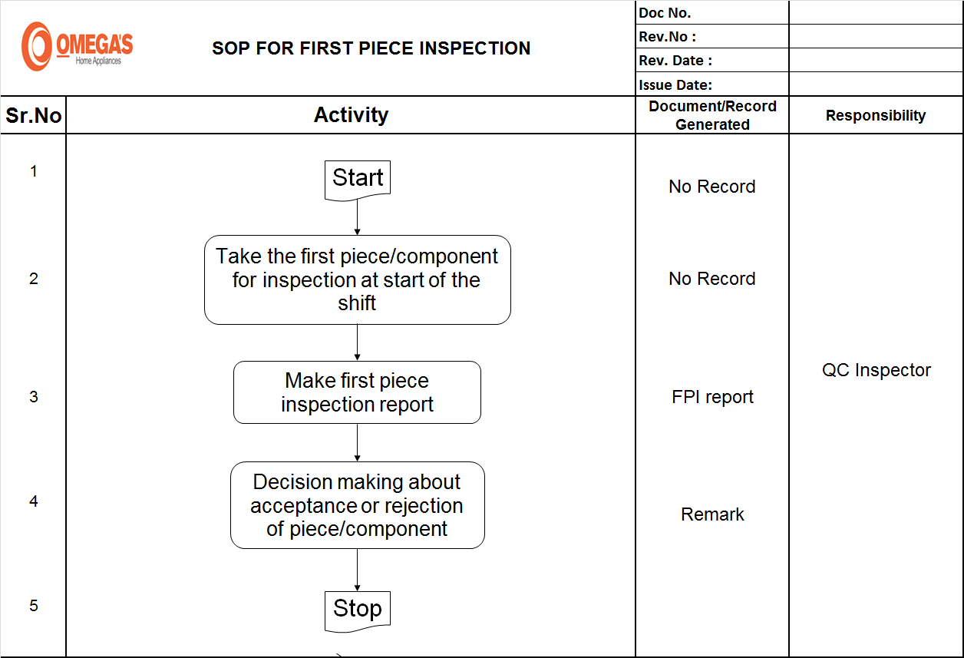
SOP for FPI

Slide 13
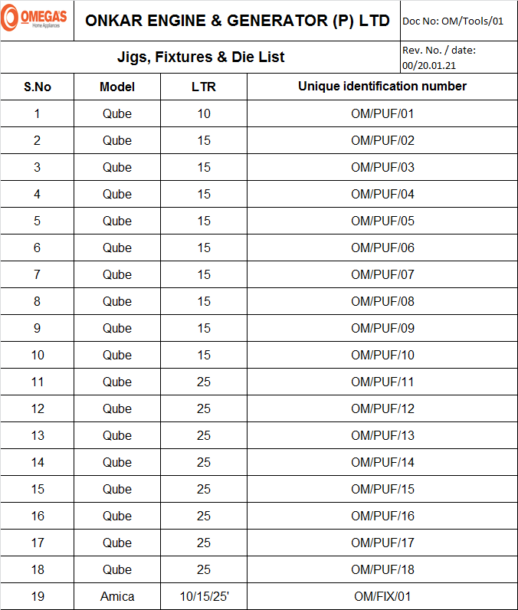
List of Jig fixtures & Die

Slide 14
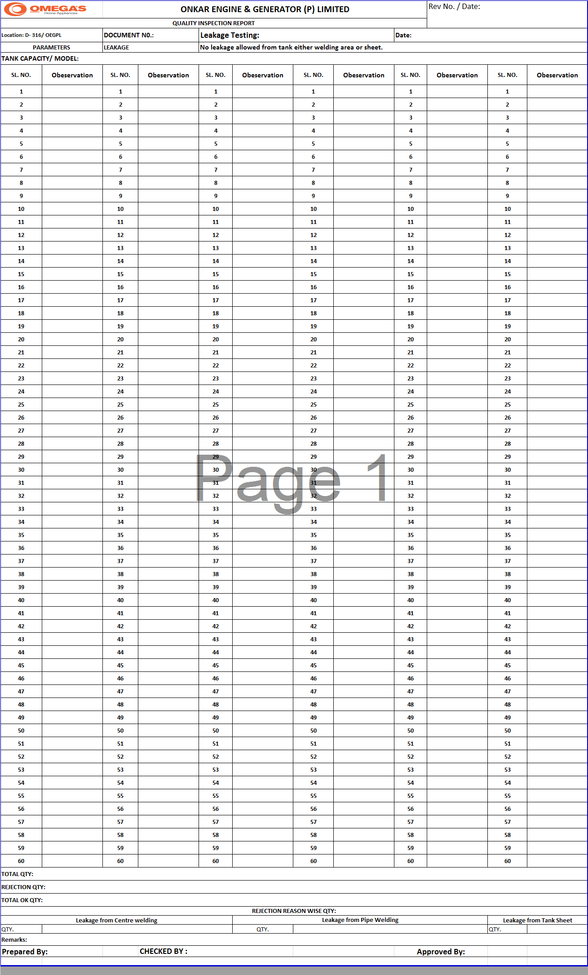
Defects Record

Slide 15
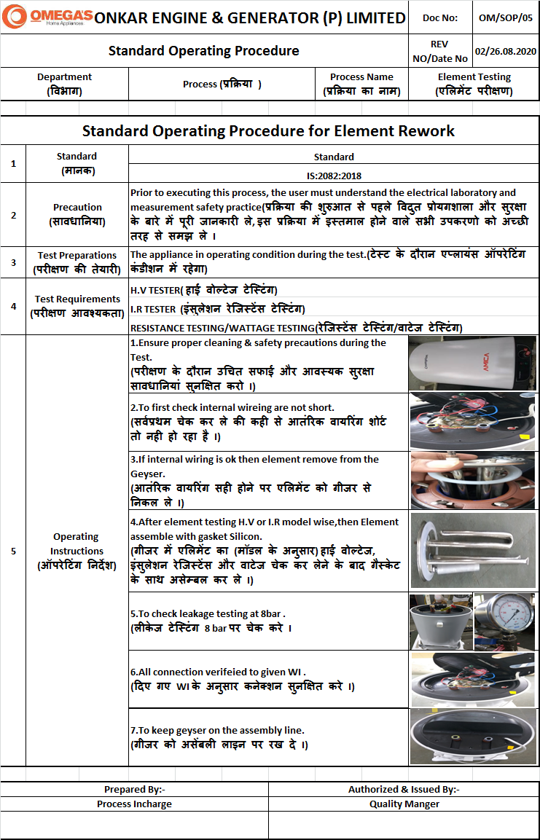
Rework SOP

Slide 16
Score Card

Slide 17
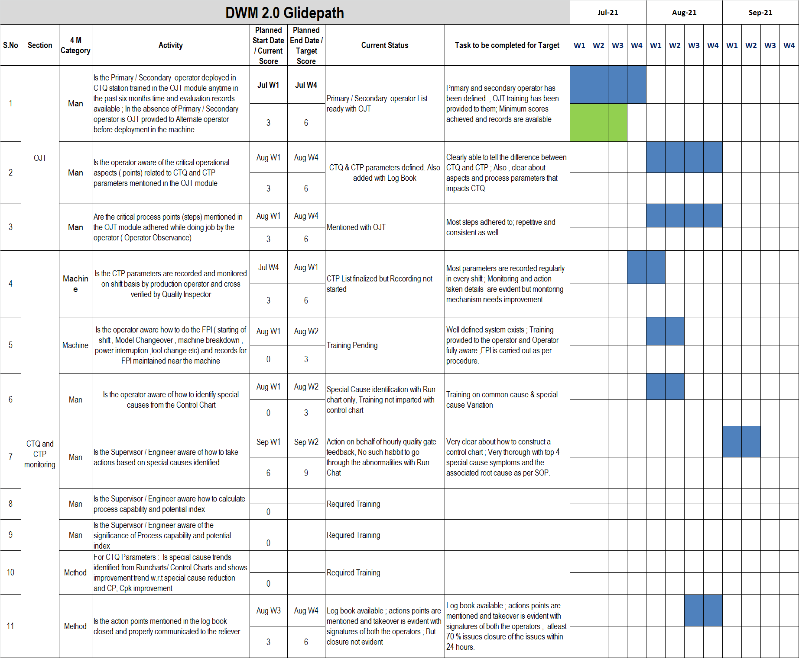
DWM 2.0 – Glide path (Score 3 to 6)

Slide 18
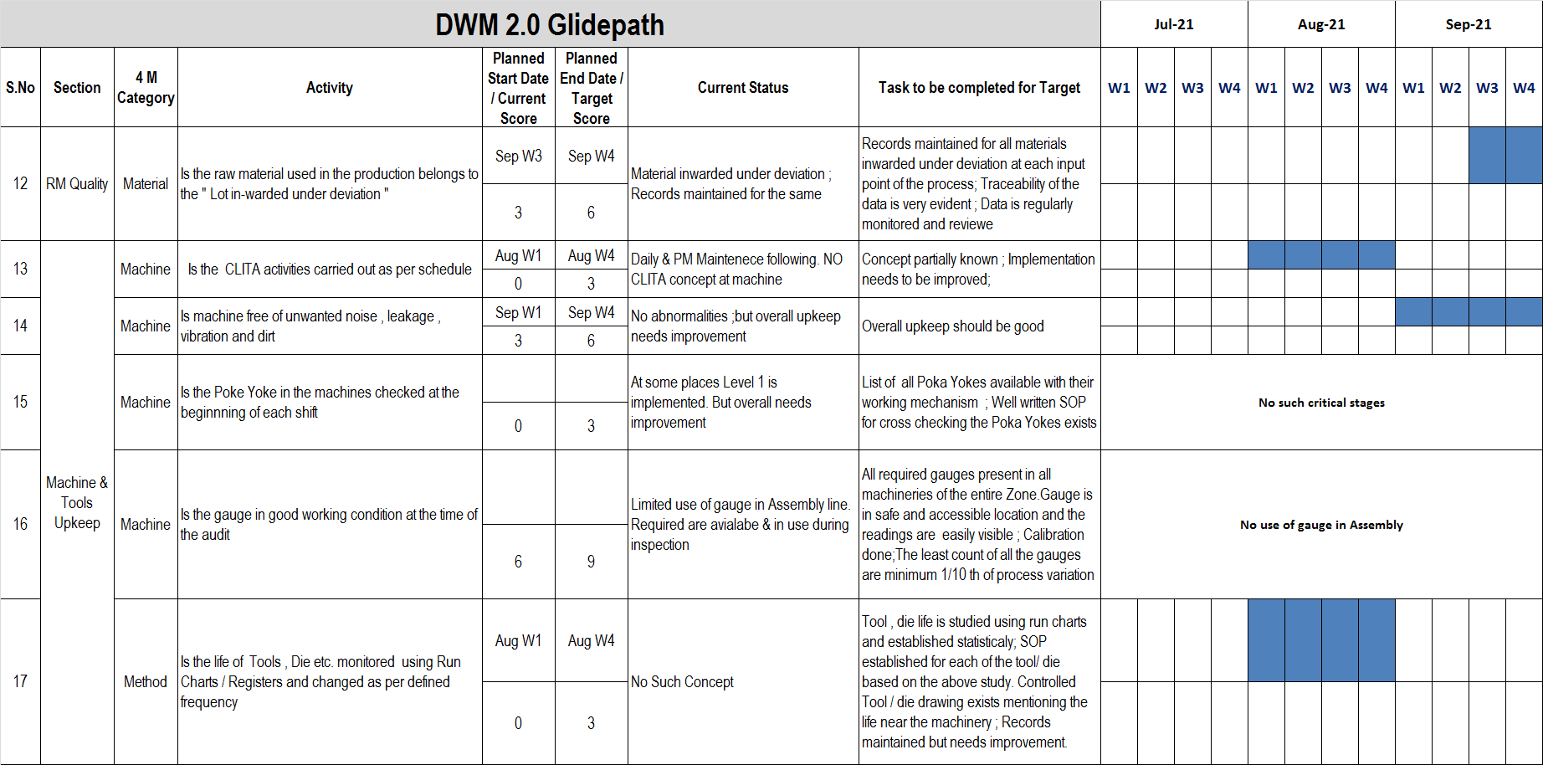
DWM 2.0 – Glide path (Score 3 to 6)

Slide 19
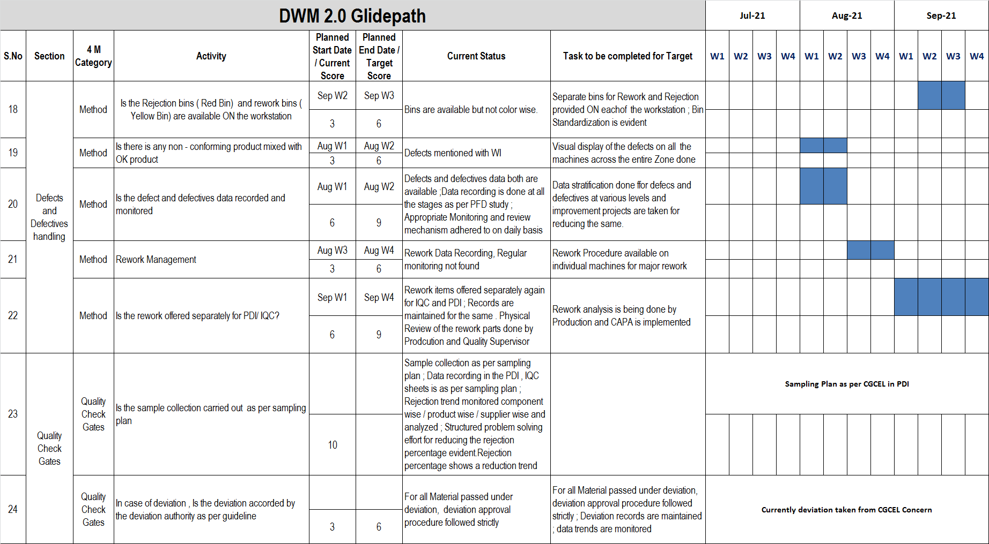
DWM 2.0 – Glide path (Score 3 to 6)

Slide 20
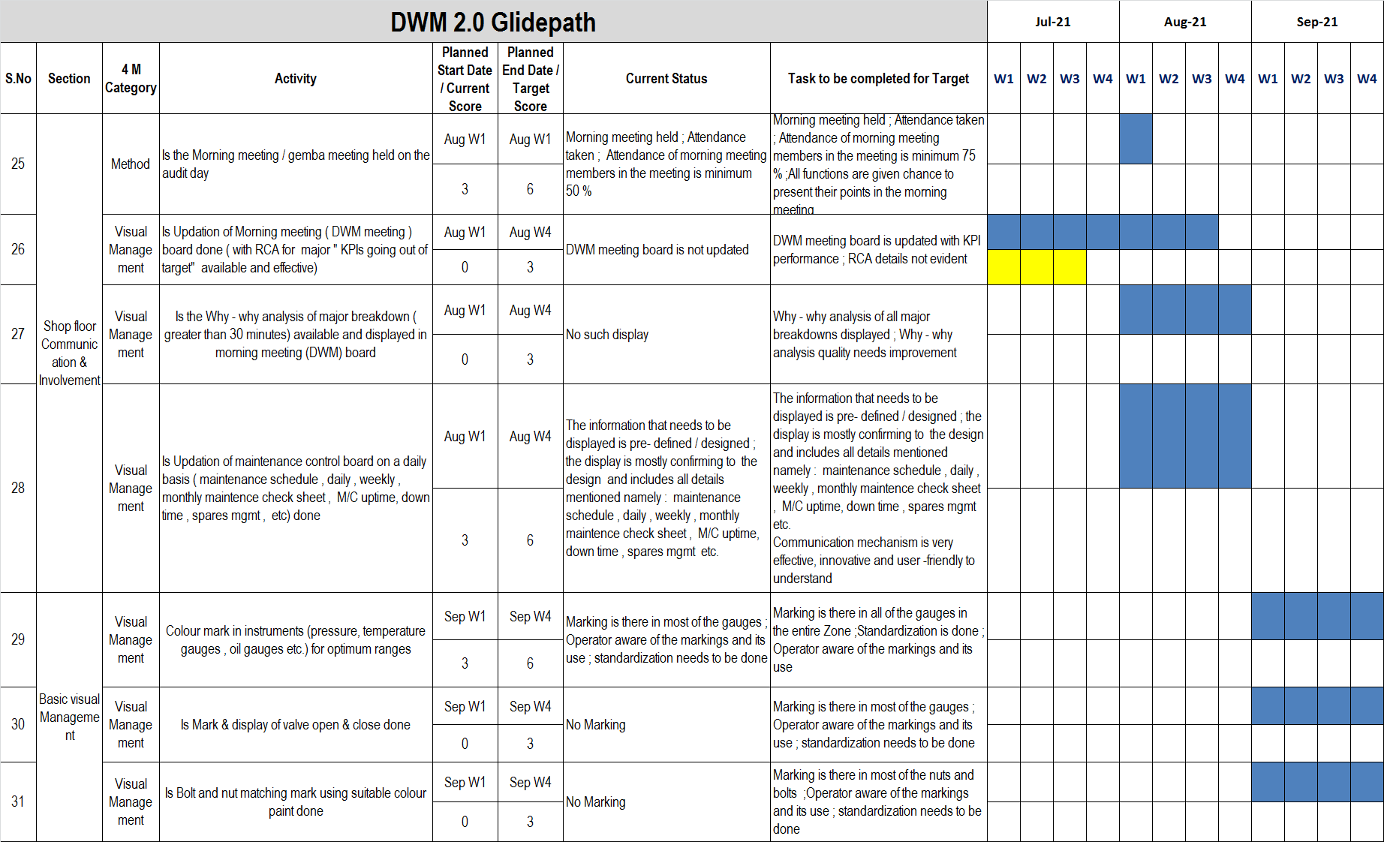
DWM 2.0 – Glide path (Score 3 to 6)

